Slide 1
Loan Classification
Exploratory and Machine Learning Techniques to Predict Loan Status

Slide 2
Introduction
Lenders take risks when making loans.
Uncertain as to outcome of loans.
Either fully repaid or default.
More perceived risk, the greater the potential reward.
More risk = high interest rate
Grades are reflections of risk
Data obtained, wrangled, explored, and used to construct logistic regression and random forest models.
Estimates classification of loan

Slide 3
Data Wrangling
Data obtained from Lending Club website
42,536 observations
Each assigned a member ID integer
23 features used
Dropped columns contained vague text, settlement and collections data, payments during loans, date data types, and residences.
String converted to categorical types
Profit/ loss margins and totals were added for exploratory purposes

Slide 4
Features
 | Columns
0 | loan_amnt
1 | funded_amnt
2 | funded_amnt_inv
3 | term
4 | int_rate
5 | installment
6 | grade
7 | emp_length
8 | home_ownership
9 | annual_inc
10 | verification_status
11 | loan_status
12 | purpose
13 | dti
14 | delinq_2yrs
15 | inq_last_6mths
16 | open_acc
17 | pub_rec
18 | revol_bal
19 | revol_util
20 | total_acc
21 | total_pymnt
22 | pub_rec_bankruptcies

Slide 5
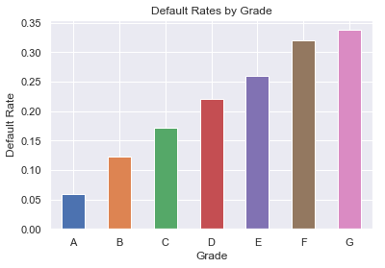
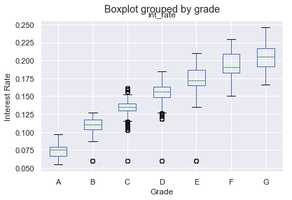
Exploratory Data Analysis
Default rates increase as we go from grades A to G.
Interest rates increase as we go from grades A to B
Greater risk = greater potential reward
The differences seem practically significant

Slide 6
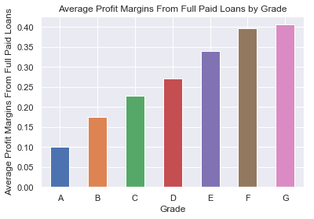
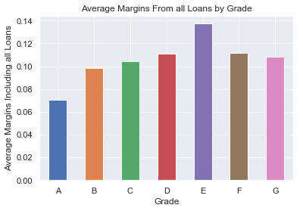
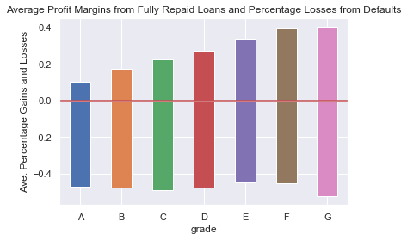
EDA cont.
Average profit margins from fully repaid loans increase from grade to grade (plot above)
Incentives exist for taking on greater risk
The middle plot includes losses from defaults
The spread between A grade and G grade lowers significantly due to more defaults among the G graded creditors.
The lowest plot compares profit margins from fully paid loans to percentage losses from defaults.

Slide 7
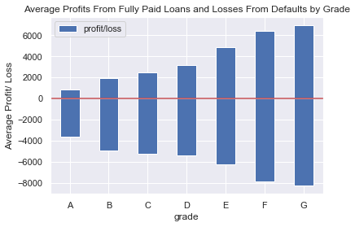
EDA cont.
Above the zero on the Y axis are the average returns, in term of
dollars, from fully paid loans for each grade. Below the zero on the
Y axis is the average loss from defaults for each grade.

Slide 8
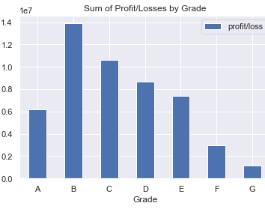
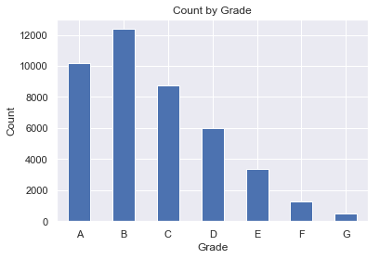
EDA cont.
Plot above show the sum of all returns and losses
It differs a lot from the margins plot
Due to amount of loans per grade
Many more loans to higher grades than lower grades
Lenders are more cautious despite incentive (higher margins potential)
Lenders want to limit defaults across all grades without infringing on potential gains.
And perhaps may want to exploit higher potential rewards from lower graded debtors without taking more risk.

Slide 9
Statistical Inference
Differences in risk and potential rewards are significant.
The differences in defaults rates between grads are statistically significant with p values of less than 0.0.
Except between F and G, p value = 0.24
The differences in interest rates between all grades are significant with p values less than 0.0.

Slide 10
Statistical Inference cont.
The distributions of the percentages of returns and losses were analyzed.
This indicates the extent to which potential rewards are reaped
The pairs of grades not listed have p values of less than 0.0.
B C 0.014 B G 0.02 C D 0.04 C G 0.17 D F 0.0668 D G 0.4011 E F 0.2596 E G 0.1261 F G 0.2978

Slide 11
Statistic Inference Review
The differences in defaults rates between the grades are statistically significant, expect for in one case
The potential rewards between grades, as given by the interest rates, are significantly different.
The actual rewards between grades are not all significantly different.
A lender would like for the actual rewards to be significantly different given the differences in risk
Machine learning techniques can help in that regard

Slide 12
In Depth Analysis
Data was divided into features set X and their corresponding labels y
Aggregate (model containing all grades) logistic regression was built first
AUC is 0.9435
Cross Validation was used to optimize aggregate model
The following is the classification report
precision recall f1-score support
0 0.97 1.00 0.98 9063 1 0.99 0.80 0.89 1571 avg / total 0.97 0.97 0.97 10634

Slide 13
In Depth Analysis cont.
The data was divided between grades
The average AUC for the segmented models is 0.9617, compared to 0.9436 AUC score for the aggregate model
The models were tuned using grid search and cross validation

Slide 14
In Depth Analysis cont. (Classification Reports for all Grades)
A precision recall f1-score support 0 0.99 1.00 1.00 2387 1 0.99 0.91 0.95 159
avg / total 0.99 0.99 0.99 2546
B precision recall f1-score support 0 0.98 1.00 0.99 2709 1 1.00 0.84 0.91 389 avg / total 0.98 0.98 0.98 3098
C precision recall f1-score support 0 0.96 1.00 0.98 1790 1 1.00 0.83 0.90 395 avg / total 0.97 0.97 0.97 2185 D precision recall f1-score support 0 0.95 0.99 0.97 1172 1 0.97 0.83 0.89 332 avg / total 0.96 0.96 0.95 1504
E precision recall f1-score support 0 0.92 0.98 0.95 608 1 0.94 0.80 0.86 241
avg / total 0.93 0.93 0.93 849
F precision recall f1-score support 0 0.91 1.00 0.95 221 1 1.00 0.79 0.88 105 avg / total 0.94 0.93 0.93 326
G precision recall f1-score support 0 0.97 1.00 0.98 83 1 1.00 0.93 0.97 45 avg / total 0.98 0.98 0.98 2185
Agg. precision recall f1-score support 0 0.97 1.00 0.98 9063 1 0.99 0.80 0.89 1571 avg / total 0.97 0.97 0.97 10634

Slide 15
In Depth Analysis cont. (Comparing metrics from aggregate model and segmented models.
The A, B, and G segmented grade models had better precision and recall than the aggregate model.
A and G had recall rates for defaults of 0.91 and 0.93 respectively, compared to 0.80 from the aggregate model.
C graded models had recall of 0.83 for defaults

Slide 16
In Depth Analysis cont.
D, E, and F graded models had lower precision and recall than the aggregate model.
However, the aggregate model needs to be tested against those respective grades.
This classification reports then need to be compared to those of the segmented models. (This can be done to all the logistic models for evaluation)

Slide 17
In Depth Analysis cont. (Random forest)
The model was tuned using grid search and cross validation.
The following is the classification report for the random forest
F precision recall f1-score support 0 0.91 1.00 0.95 221 1 1.00 0.79 0.88 105
avg / total 0.94 0.93 0.93 326

Slide 18
In Depth Analysis Conclusion.
For the most part, the models did identify all of the fully repaid loans in the data as such, maximizing the amount of successful loan.
At the same time, the logistic regressions identified over 80% of defaults.
The random forest identified over 60% of default.
Final Point: Had these models existed and been relied upon when the loans in the data were made, all of the fully repaid loans would have been made, but defaults would have been less than by over 60%.
That’s pretty good!

Slide 19
Conclusion
The grades are decent reflections of risk, or default potential
Greater risk = greater potential reward
Potential reward > actual reward, by a considerable amount
The goal is to lower defaults without lowering successful loans.
The predictive models would have done just that!
If factors not accounted for in the model remain equal, the models will very likely decrease future defaults if relied upon.

